Slide 1
Inference in First-Order logic

Slide 2
Inference rules
Universal elimination:
∀ x Likes( x, IceCream ) with the substitution {x / Einstein} gives us Likes( Einstein, IceCream )
The substitution has to be done by a ground term
Existential elimination:
From ∃ x Likes( x, IceCream ) we infer Likes( Man, IceCream ) as long as Man does not appear elsewhere in the Knowledge base
Existential introduction:
From Likes( Lisa, IceCream ) we can infer
∃ x Likes( x, IceCream )

Slide 3
Inference Rules
Universal Instantiation
Infer a sentence obtained by substituting a ground term for the variable.
∀x cat(x) ⇒ mammal(x); cat(Felix), therefore, mammal(Felix)
Existential Generalization
Q(A) → ∃x Q(x) ….

Slide 4
Inference Rules
Modus ponens
And elimination
And introduction
Or introduction
P(x) ⇒ Q(x) , P(A)
Q(A)
P(A) ∧ Q(A) ∧ R(A) ∧ S(A) ∧ …….
P(A)
P(A) , Q(A) , R(A) , S(A) , …….
P(A) ∧ Q(A) ∧ R(A) ∧ S(A) ∧ …….
P(A)
P(A) ∨ Q(A) ∨ R(A) ∨ S(A) ∨ …….

Slide 5
Inference Rules
Double Negation elimination
Unit resolution
Resolution
¬ ¬ P(x)
P(x)
P(x) ∨ Q(x) , ¬ P(A)
Q(A)
P(x) ∨ Q(x) , ¬ Q(x) ∨ R(x)
P(x) ∨ R(x)

Slide 6
Additional Rules of Inference
substitution
SUBST(Θ,S), substituting (or binding list) Θ to sentence S
SUBST({x/5,y/3}, gt(x,y)) = gt(5,3)
Additional Rules
Universal Elimination
Existential Elimination
Existential Introduction
∀x Likes(x,IceCream)
{x/Ben}, Likes(Ben,IceCream)
∃x Likes(x,Sally) If Ben doesn’t
{x/Ben}, Likes(Ben,Sally) appear elsewhere
Likes(John,IceCream)
∃x Likes(x,IceCream)

Slide 7
Additional rules of inference
Unification
UNIFY(p, q) = θ where SUBST(θ, q)
Examples:
UNIFY(Knows(John, x), Knows(John, Jane)) = {x/Jane}
UNIFY(Knows(John, x), Knows(y, Mother(y))) =
{y/John, x/Mother(John)}

Slide 8
Forward Chaining
Start with atomic Knowledge base sentences, apply rules of inference, adding new atomic sentences, until no further inferences can be made.
∀x,y,z gt(x,y) ∧ gt(y,z) ⇒ gt(x,z)
Given: gt(A,B), gt(B,C), and gt(C,D) can we say gt(A,D)?
Step 1: gt(A,B) ∧ gt(B,C) ⇒ gt(A,C)
Step 2: gt(A,C) ∧ gt(C,D) ⇒ gt(A,D); Therefore, gt(A,D)
Typically triggered when a new fact, p, is added to
the knowledge base. Then we find all implications
that have p as premise – can also use other premises
that are known to be true

Slide 9
Example Problem
John likes all kinds of food.
Apples are food.
Chicken is food.
Anything anyone eats and isn’t killed by is food.
Bill eats peanuts, and is still alive.
Sue eats everything that Bill eats.

Slide 10
Example Problem
John likes all kinds of food | ∀x food (x) ⇒ eats(John, x)
Apples are food. | food(apples)
Chicken is food. | food(chicken)
Anything anyone eats and isn’t killed by is food. | ∀x,y eats(x,y) ∧ ¬killed(x) ⇒ food(y)
Bill eats peanuts, and is still alive. | eats(Bill,Peanuts) ∧ ¬killed(Bill)
Sue eats everything that Bill eats. | ∀x eats (Bill,x) ⇒ eats(Sue,x)

Slide 11
Answer Questions (by Proof)
Does John eat peanuts?
1) eats(Bill,Peanuts) ∧ ¬killed(Bill)
2) ∀x,y eats(x,y) ∧ ¬killed(x) ⇒ food(y)
SUBST({x/Bill,y/Peanuts}), universal elimination, and modus
ponens to derive food(peanuts)
3) ∀x food (x) ⇒ eats(John, x)
SUBST({x/Peanuts}) and use (2, universal elimination, and
modus ponens to derive eats(John,peanuts)
Derived Proof by Forward Chaining
The proof steps could have been longer – if we had tried other derivations
For example, many possibilities for substitution and universal elimination
Need search strategies to perform this task efficiently

Slide 12
Pictorial View: Forward Chaining
eats(John, Peanuts)
eats(John, apples)
∀x food (x) ⇒ eats(John, x)
eats(John, chicken)
food(Peanuts)
∀x,y eats(x,y) ∧ ¬killed(x) ⇒ food(y)
¬ killed(Bill)
food(chicken)
food(apples)
eats(Bill,Peanuts)

Slide 13
More Efficient Forward Chaining
Checking all rules will take too much time.
Check only rules that include a conjunct that unifies a newly created fact during the previous iteration.
Incremental Forward Chaining

Slide 14
Forward Chaining
Data Driven
not directed at finding particular information – can generate irrelevant conclusions
Strategy
match rules that contain recently added literals
Forward chaining may not terminate
Especially if desired conclusion is not entailed (Incomplete)

Slide 15
Backward Chaining
Start at the goal, chain through inference rules to find known facts that support the proof.
Uses Modus Ponens backwards
Designed to answer questions posed to a knowledge base
In reality, the
algorithm would
include all appropriate
rules.
eats(John, y)
Yes, y/peanuts
food (y)
Yes, y/peanuts
eats(x,y) ¬killed(x)
Yes, x/Bill, y/peanuts
Yes, x/Bill

Slide 16
Inference rules
Universal elimination:
∀ x Likes( x, IceCream ) with the substitution {x / Einstein} gives us Likes( Einstein, IceCream )
The substitution has to be done by a ground term
Existential elimination:
From ∃ x Likes( x, IceCream ) we infer Likes( Man, IceCream ) as long as Man does not appear elsewhere in the Knowledge base
Existential introduction:
From Likes( Lisa, IceCream ) we can infer
∃ x Likes( x, IceCream )

Slide 17
Reasoning in first-order logic
The law says that it is a crime for a Gaul to sell potion formulas to hostile nations.
The country Rome, an enemy of Gaul, has acquired some potion formulas, and all of its formulas were sold to it by Druid Traitorix,
Traitorix is a Gaul.
Is Traitorix a criminal?

Slide 18
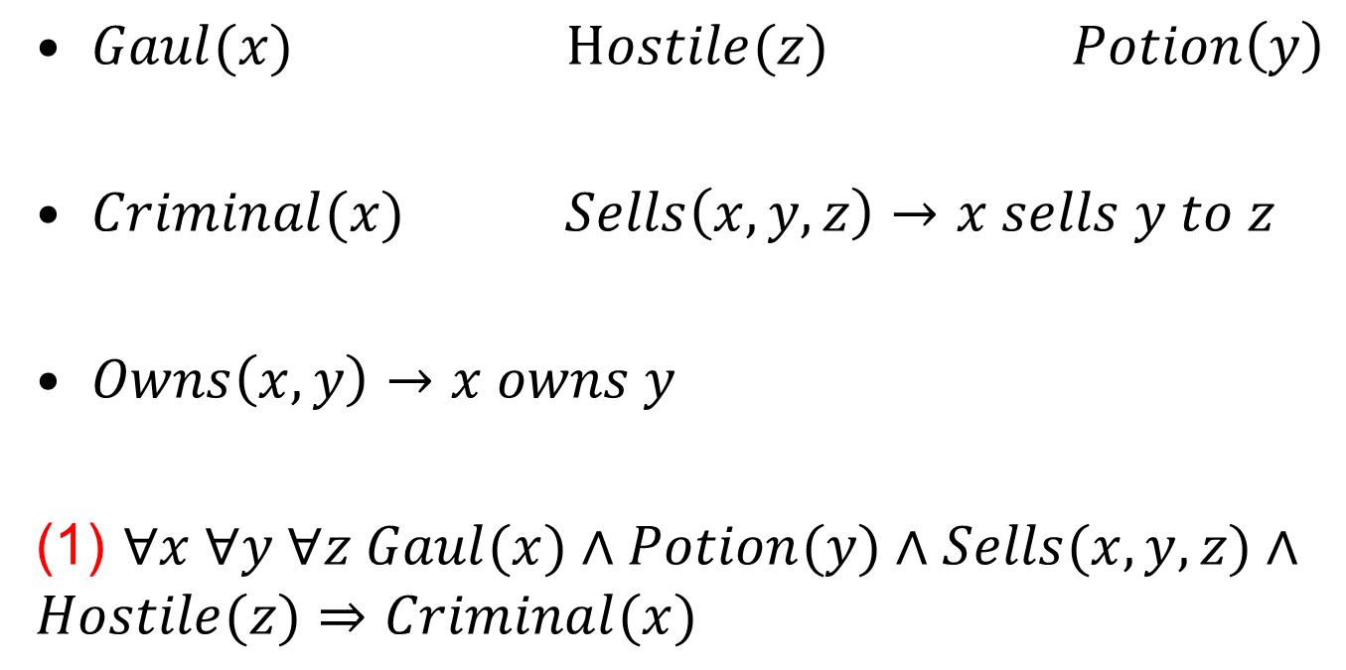
FoL Formulation
The law says that it is a crime for a Gaul to sell potion formulas to hostile nations.

Slide 19
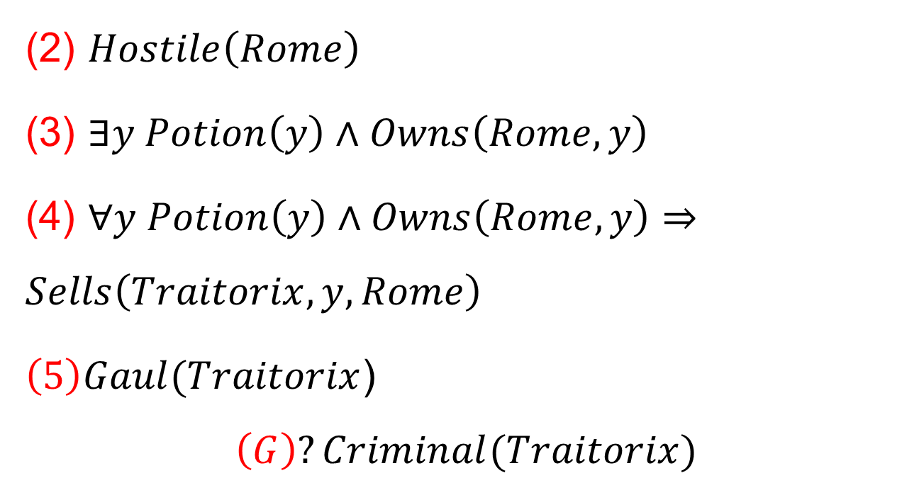
The country Rome, an enemy of Gaul, has acquired some potion formulas, and all of its formulas were sold to it by Druid Traitorix,

Slide 20

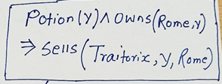







Forward Chaning

Slide 21
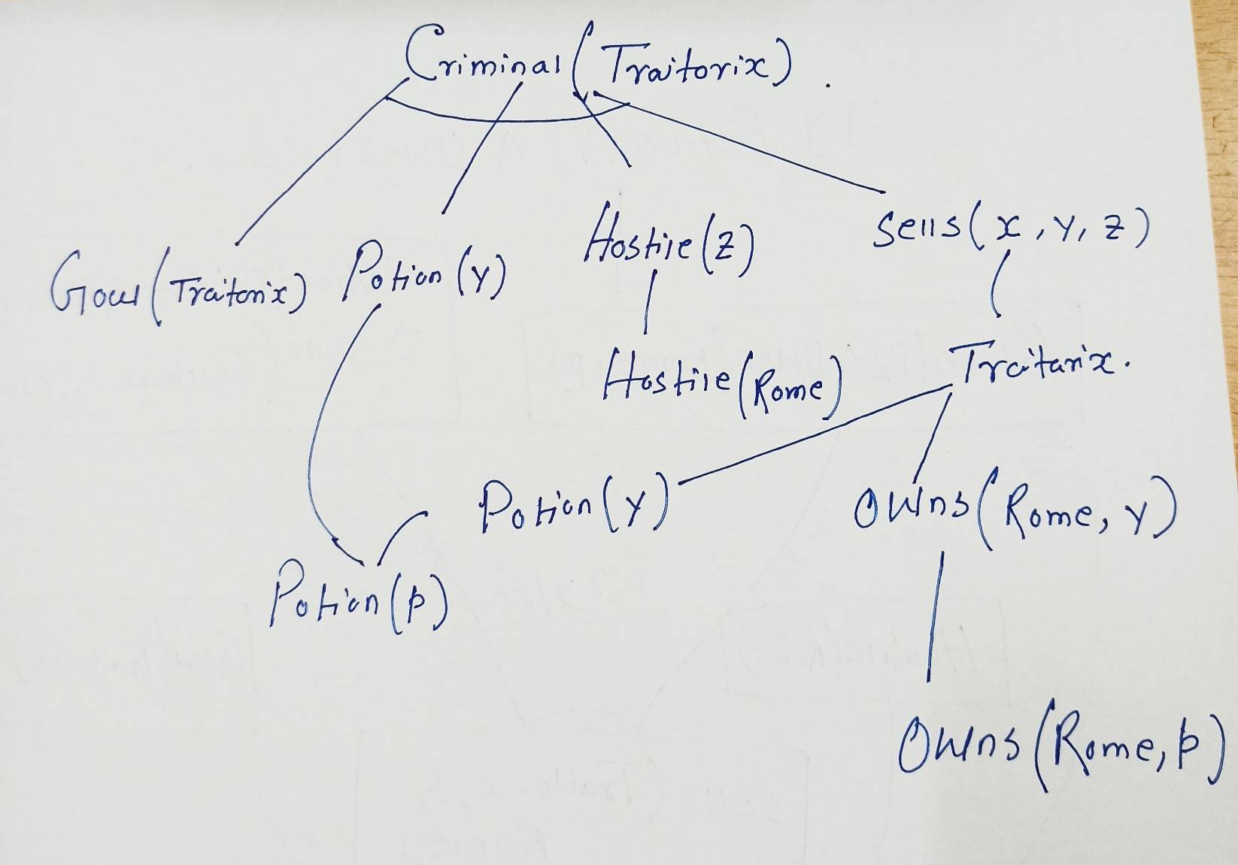
Backward Chaning

Slide 22
Generalized Modus Ponens
Generalized Modus Ponens
For atomic sentences p_{i}, p_{i}’, and q, where there is a substitution θ such that SUBST(θ, p_{i}’) = SUBST(θ, p_{i}),
for all i:

Slide 23
Unification
UNIFY(p,q) = θ where SUBST(θ,p) = SUBST(θ,q)
Examples:
UNIFY( Knows(Erdos, x), Knows(Erdos, Godel)) = {x / Godel}
UNIFY( Knows(Erdos, x), Knows(y,Godel)) = {x/Godel, y/Erdos}
UNIFY( Knows(Erdos, x), Knows(y, Father(y)))
= { y/Erdos, x/Father(Erdos) }
UNIFY( Knows(Erdos, x), Knows(x, Godel)) = fail

Slide 24
Example knowledge base
The law says that it is a crime for an American to sell weapons to hostile nations. The country Nono, an enemy of America, has some missiles, and all of its missiles were sold to it by Colonel West, who is American.
Prove that Col. West is a criminal

Slide 25
Example knowledge base
It is a crime for an American to sell weapons to hostile nations:
American(x) ∧ Weapon(y) ∧ Sells(x,y,z) ∧ Hostile(z) ⇒ Criminal(x)
Nono has some missiles
∃x Owns(Nono,x) ∧ Missile(x)
Owns(Nono,M₁) ∧ Missile(M₁)
All of its missiles were sold to it by Colonel West
Missile(x) ∧ Owns(Nono,x) ⇒ Sells(West,x,Nono)
Missiles are weapons:
Missile(x) ⇒ Weapon(x)
An enemy of America counts as “hostile”:
Enemy(x,America) ⇒ Hostile(x)
West is American
American(West)
The country Nono is an enemy of America
Enemy(Nono,America)

Slide 26
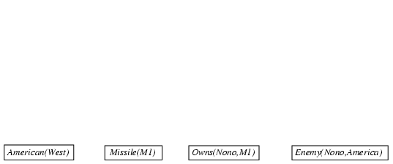
Forward chaining proof
American(x) ∧ Weapon(y) ∧ Sells(x,y,z) ∧ Hostile(z) ⇒ Criminal(x)
Owns(Nono,M₁) ∧ Missile(M₁)
Missile(x) ∧ Owns(Nono,x) ⇒ Sells(West,x,Nono)
Missile(x) ⇒ Weapon(x) Enemy(x,America) ⇒ Hostile(x)
American(West) Enemy(Nono,America)

Slide 27
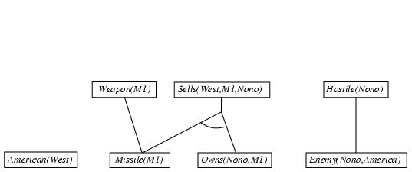
Forward chaining proof
American(x) ∧ Weapon(y) ∧ Sells(x,y,z) ∧ Hostile(z) ⇒ Criminal(x)
Owns(Nono,M₁) ∧ Missile(M₁)
Missile(x) ∧ Owns(Nono,x) ⇒ Sells(West,x,Nono)
Missile(x) ⇒ Weapon(x) Enemy(x,America) ⇒ Hostile(x)
American(West) Enemy(Nono,America)

Slide 28
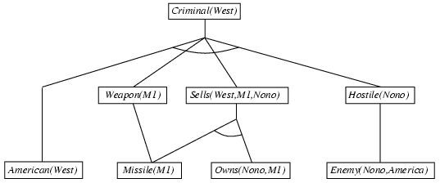
Forward chaining proof
American(x) ∧ Weapon(y) ∧ Sells(x,y,z) ∧ Hostile(z) ⇒ Criminal(x)
Owns(Nono,M₁) ∧ Missile(M₁)
Missile(x) ∧ Owns(Nono,x) ⇒ Sells(West,x,Nono)
Missile(x) ⇒ Weapon(x) Enemy(x,America) ⇒ Hostile(x)
American(West) Enemy(Nono,America)

Slide 29

Backward chaining example
American(x) ∧ Weapon(y) ∧ Sells(x,y,z) ∧ Hostile(z) ⇒ Criminal(x)
Owns(Nono,M₁) ∧ Missile(M₁)
Missile(x) ∧ Owns(Nono,x) ⇒ Sells(West,x,Nono)
Missile(x) ⇒ Weapon(x) Enemy(x,America) ⇒ Hostile(x)
American(West) Enemy(Nono,America)

Slide 30
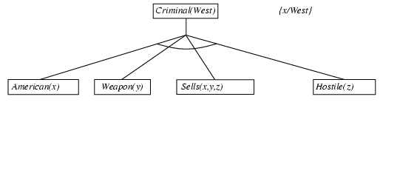
Backward chaining example
American(x) ∧ Weapon(y) ∧ Sells(x,y,z) ∧ Hostile(z) ⇒ Criminal(x)
Owns(Nono,M₁) ∧ Missile(M₁)
Missile(x) ∧ Owns(Nono,x) ⇒ Sells(West,x,Nono)
Missile(x) ⇒ Weapon(x) Enemy(x,America) ⇒ Hostile(x)
American(West) Enemy(Nono,America)

Slide 31
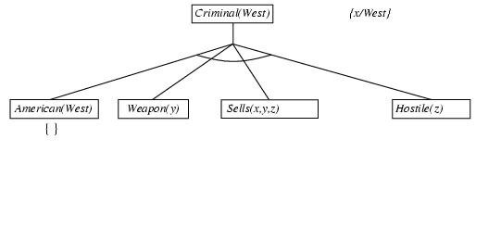
Backward chaining example
American(x) ∧ Weapon(y) ∧ Sells(x,y,z) ∧ Hostile(z) ⇒ Criminal(x)
Owns(Nono,M₁) ∧ Missile(M₁)
Missile(x) ∧ Owns(Nono,x) ⇒ Sells(West,x,Nono)
Missile(x) ⇒ Weapon(x) Enemy(x,America) ⇒ Hostile(x)
American(West) Enemy(Nono,America)

Slide 32
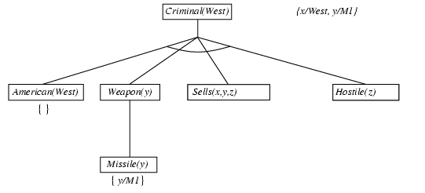
Backward chaining example
American(x) ∧ Weapon(y) ∧ Sells(x,y,z) ∧ Hostile(z) ⇒ Criminal(x)
Owns(Nono,M₁) ∧ Missile(M₁)
Missile(x) ∧ Owns(Nono,x) ⇒ Sells(West,x,Nono)
Missile(x) ⇒ Weapon(x) Enemy(x,America) ⇒ Hostile(x)
American(West) Enemy(Nono,America)

Slide 33
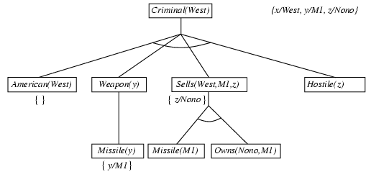
Backward chaining example
American(x) ∧ Weapon(y) ∧ Sells(x,y,z) ∧ Hostile(z) ⇒ Criminal(x)
Owns(Nono,M₁) ∧ Missile(M₁)
Missile(x) ∧ Owns(Nono,x) ⇒ Sells(West,x,Nono)
Missile(x) ⇒ Weapon(x) Enemy(x,America) ⇒ Hostile(x)
American(West) Enemy(Nono,America)

Slide 34
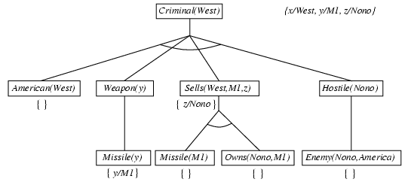
Backward chaining example
American(x) ∧ Weapon(y) ∧ Sells(x,y,z) ∧ Hostile(z) ⇒ Criminal(x)
Owns(Nono,M₁) ∧ Missile(M₁)
Missile(x) ∧ Owns(Nono,x) ⇒ Sells(West,x,Nono)
Missile(x) ⇒ Weapon(x) Enemy(x,America) ⇒ Hostile(x)
American(West) Enemy(Nono,America)

Slide 35
Reasoning with Horn Logic
If all sentences are Horn sentences, then we can convert them to a canonical form and then use generalized Modus Ponens with unification.
We skolemize existential formulas and remove the universal ones
This gives us a conjunction of clauses, that are inserted in the KB
Modus Ponens help us in infering new clauses
Forward chaining
Backward chaining

Slide 36
Completeness issues
Reasoning with Modus Ponens is incomplete
Consider the example –
∀x P(x) ⇒ Q(x)
∀x ¬P(x) ⇒ R(x)
∀x Q(x) ⇒ S(x)
∀x R(x) ⇒ S(x)
We should be able to conclude S(A)
The problem is that ∀x ¬P(x) ⇒ R(x) cannot be converted to Horn form, and thus cannot be used by Modus Ponens

Slide 37
Godel’s Completeness Theorem
For first-order logic, any sentence that is entailed by another set of sentences can be proved from that set
Godel did not suggest a proof procedure
In 1965 Robinson published his resolution algorithm
Entailment in first-order logic is semi-decidable, that is, we can show that sentences follow from premises if they do, but we cannot always show if they do not

Slide 38
The validity problem of first-order logic
[Church] The validity problem of the first-order predicate calculus is partially solvable.
Consider the following formula:

Slide 39
Resolution
Generalized Resolution Rule:
For atoms p_{i}, q_{i}, r_{i}, s_{i}, where Unify(p_{j}, q_{k}) = θ, we have:

Slide 40
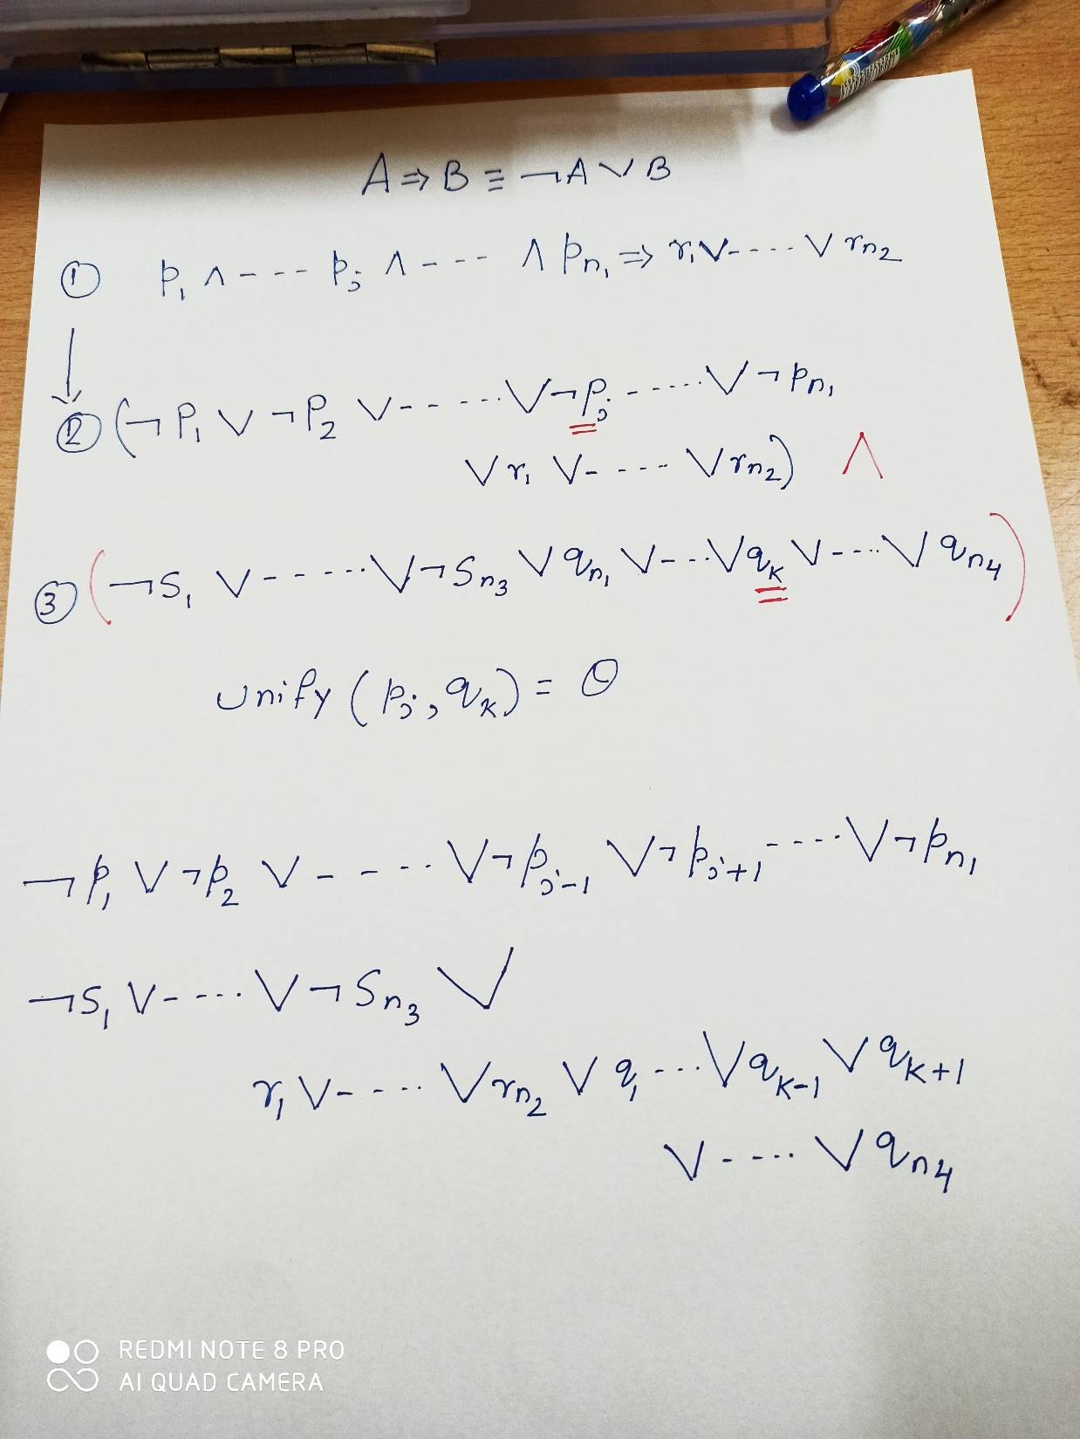
Proof of Resolution

Slide 41
Example
P(w) ⇒ Q(w)
Q(y) ⇒ S(y)
{y / w}
P(w) ⇒ S(w)
True ⇒ P(x) ∨ R(x)
{w / x}
True ⇒ S(x) ∨ R(x)
R(z) ⇒ S(z)
{x/A, z/A}
True ⇒ S(A)

Slide 42
Conversion to Normal Form
A formula is said to be in clause form if it is of the form:
∀x₁ ∀x₂ … ∀x_{n} [C₁ ∧ C₂ ∧ … ∧ C_{k}]
All first-order logic formulas can be converted to clause form
We shall demonstrate the conversion on the formula:
∀x {p(x) ⇒ ∃z { ¬∀y [q(x,y) ⇒ p(f(x₁))] ∧ ∀y [q(x,y) ⇒ p(x)] }}

Slide 43
Conversion to Normal Form
Step1: Take the existential closure and eliminate redundant quantifiers. This introduces ∃x₁ and eliminates ∃z, so:
∀x {p(x) ⇒ ∃z { ¬∀y [q(x,y) ⇒ p(f(x₁))] ∧ ∀y [q(x,y) ⇒ p(x)] }}
∃x₁ ∀x {p(x) ⇒ { ¬∀y [q(x,y) ⇒ p(f(x₁))] ∧ ∀y [q(x,y) ⇒ p(x)] }}
Step 2: Rename any variable that is quantified more than once.
y has been quantified twice, so:
∃x₁ ∀x {p(x) ⇒ { ¬∀y [q(x,y) ⇒ p(f(x₁))] ∧ ∀y [q(x,y) ⇒ p(x)] }}
∃x₁ ∀x {p(x) ⇒ { ¬∀y [q(x,y) ⇒ p(f(x₁))] ∧ ∀z [q(x,z) ⇒ p(x)] }}

Slide 44
Conversion to Normal Form
Step 3: Eliminate implication.
∃x₁ ∀x {p(x) ⇒ { ¬∀y [q(x,y) ⇒ p(f(x₁))] ∧ ∀z [q(x,z) ⇒ p(x)] }}
∃x₁ ∀x {¬p(x) ∨ { ¬∀y [¬q(x,y) ∨ p(f(x₁))] ∧ ∀z [¬q(x,z) ∨ p(x)] }}
Step 4: Move ¬ all the way inwards.
∃x₁ ∀x {¬p(x) ∨ { ¬∀y [¬q(x,y) ∨ p(f(x₁))] ∧ ∀z [¬q(x,z) ∨ p(x)] }}
∃x₁ ∀x {¬p(x) ∨ {∃y [q(x,y) ∧ ¬p(f(x₁))] ∧ ∀z [¬q(x,z) ∨ p(x)] }}

Slide 45
Conversion to Normal Form
Step 5: Push the quantifiers to the right.
∃x₁ ∀x {¬p(x) ∨ {∃y [q(x,y) ∧ ¬p(f(x₁))] ∧ ∀z [¬q(x,z) ∨ p(x)] }}
∃x₁ ∀x {¬p(x) ∨ {[∃y q(x,y) ∧ ¬p(f(x₁))] ∧ [∀z ¬q(x,z) ∨ p(x)] }}

Slide 46
Conversion to Normal Form
Step 6: Eliminate existential quantifiers (Skolemization).
Pick out the leftmost ∃y B(y) and replace it by B(f(x_{i1}, x_{i2},…, x_{in})), where:
x_{i1}, x_{i2},…, x_{in} are all the distinct free variables of ∃y B(y) which are universally quantified to the left of ∃y B(y), and
F is any n-ary function constant which does not occur already
∃x₁ ∀x {¬p(x) ∨ {[∃y q(x,y) ∧ ¬p(f(x₁))] ∧ [∀z ¬q(x,z) ∨ p(x)] }}
∀x {¬p(x) ∨ {[q(x,g(x)) ∧ ¬p(f(a))] ∧ [∀z ¬q(x,z) ∨ p(x)] }}
Step 7: Move all universal quantifiers to the left
∀x ∀z {¬p(x) ∨ {[q(x,g(x)) ∧ ¬p(f(a))] ∧ [¬q(x,z) ∨ p(x)] }}

Slide 47
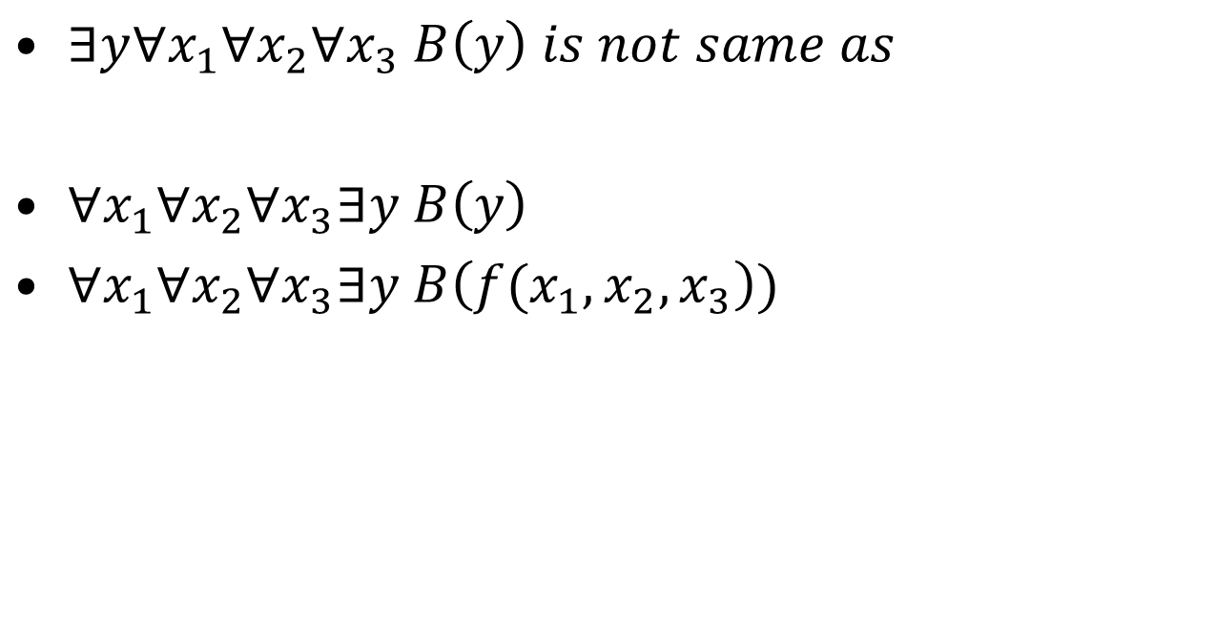
Skolemization

Slide 48
Conversion to Normal Form
Step 8: Distribute ∧ over ∨.
∀x ∀z {[¬p(x) ∨ q(x,g(x))]
∧ [¬p(x) ∨ ¬p(f(a))]
∧ [¬p(x) ∨ ¬q(x,z) ∨ p(x)] }
Step 9: (Optional) Simplify
∀x {[¬p(x) ∨ q(x,g(x))] ∧ ¬p(f(a)) }

Slide 49
Example
“Everyone who loves all animals is loved by someone,

Slide 50
FOL to CNF
Resolution requires that FOL sentences be represented in Conjunctive Normal Form (CNF)
Everyone who loves all animals is loved by someone.
FOL:
CNF:

Slide 51
Resolution
Resolution
a single inference rule
provides a complete inference algorithm when coupled with any complete search algorithm.
P(x) ∨ Q(x) , ¬ Q(x) ∨ R(x)
P(x) ∨ R(x)

Slide 52
Resolution
Implicative Form | Conjunctive normal form
∀x food (x) ⇒ eats(John, x) | ¬ food (x) ∨ eats(John, x)
food(apples) | food(apples)
food(chicken) | food(chicken)
∀x,y eats(x,y) ∧ ¬killed(x) ⇒ food(y) | ¬ eats(x,y) ∨ killed(x) ∨ food(y)
eats(Bill,Peanuts) ∧ ¬killed(Bill) | eats(Bill,Peanuts) ¬killed(Bill)
∀x eats (Bill,x) ⇒ eats(Sue,x) | ¬ eats (Bill,x) ∨ eats(Sue,x)
Forward & Backward Chaining
Resolution

Slide 53
Resolution Proof
¬ eats(x,y) ∨ killed(x) ∨ food(y)
eats(Bill,Peanuts)
{x/Bill, y/peanuts}
killed(Bill) ∨ food(peanuts)
¬killed(Bill)
¬ food (x) ∨ eats(John, x)
food(peanuts)
{x/peanuts}
eats(John, peanuts)
→ True

Slide 54
Resolution uses unification
Unification: takes two atomic expressions p and q, and generates a substitution that makes p and q look the same.
UNIFY(p,q) = θ where SUBST(θ,p) = SUBST(θ,q)
p q θ
x,y – implicitly
universally quantified
knows(John, x)
knows(John,Jane)
{x / Jane}
knows(John, x)
knows(y, Jack)
{x / Jack, y / John}
knows(John, x)
knows(y,mother(y))
{y / John, x / mother(John)}
knows(John, x)
knows(x, Jack)
fail
P & Q cannot share x

Slide 55
Generalized Resolution
Problem with Resolution: It is incomplete
Example: cannot prove p ∨ ¬ p from an empty KB
However, Resolution refutation, i.e.,
proof by contradiction has been proven to be complete
(KB ∧ ¬p ⇒ False) ⇔ (KB ⇒ p)

Slide 56
Resolution Refutation
If S is an unsatisfiable set of clauses, then the application of a finite number of resolution steps to S will yield a contradiction.

Slide 57
Resolution
Implicative Form | Conjunctive normal form
∀x food (x) ⇒ eats(John, x) | ¬ food (x) ∨ eats(John, x)
food(apples) | food(apples)
food(chicken) | food(chicken)
∀x,y eats(x,y) ∧ ¬killed(x) ⇒ food(y) | ¬ eats(x,y) ∨ killed(x) ∨ food(y)
eats(Bill,Peanuts) ∧ ¬killed(Bill) | eats(Bill,Peanuts) ¬killed(Bill)
∀x eats (Bill,x) ⇒ eats(Sue,x) | ¬ eats (Bill,x) ∨ eats(Sue,x)
Forward & Backward Chaining
Resolution

Slide 58
Resolution refutation proof
Start with: ¬ eats(John, peanuts)
¬ food (x) ∨ eats(John, x)
¬ eats(John,Peanuts)
{x/Peanuts}
¬ food(peanuts)
¬ eats(x,y) ∨ killed(x) ∨ food(y)
{y/Peanuts}
¬killed(Bill)
¬ eats(x,Peanuts) ∨ killed(x)
{x/Bill}
Conclusion:¬ eats(John, peanuts)
is false. Therefore,
eats(John, peanuts) must be True.
eats(Bill, peanuts)
¬ eats(Bill,Peanuts)
→ False

Slide 59
Resolution Refutation – Step 1
Assume:Can convert all FOL statements to conjunctive normal form (CNF).
Example: Everyone who loves all animals is loved by someone.

Slide 60
Resolution Refutation
Procedure
Eliminate implications
Reduce scope of negations (move ¬ inwards)
Standardize variables – each quantifier has a different one

Slide 61
Conversion to clause form
Eliminate existential quantifiers by skolemization
The process of removing existential quantifiers.
if unqualified existential quantifier, then replace by constant.
if quantifier is within scope of universal quantifier, have to use skolem function, e.g., z = G(x)

Slide 62
Conversion to Clause Form
Convert to prenex form – move all universal quantifiers out
Put expression in CNF (distribute ∧ over ∨)
Eliminate universal quantifiers

Slide 63
Conversion to clause form (2)
Write out as separate clauses (i.e., eliminate ∧ symbols)
In this example, there are two clauses:
Rename variables

Slide 64
Conversion to Clause Form (HW)
Work through this example:
Solution: 3 clauses

Slide 65
Resolution Refutation Theorem Proving
Procedure:
Put all sentences in KB into clause (CNF) form (Step 1)
Negate goal state, put into KB in clause form, and add to KB
Resolve clauses
Produce contradiction, i.e., the empty clause
Therefore, ¬ (negated goal) is true.

Slide 66
Resolution Refutation: Properties
Sound
any conclusion reached is true.
Complete
inference will eventually provide true conclusion
Tractability or Feasibility
Inference procedure may never terminate if expression to be proved is not true.

Slide 67
Resolution Refutation: Properties
Resolution Strategies
improve efficiency of process
Unit preference
prefer to do resolutions with unit clauses.
idea: produce short sentences, reduce them to null (false).
Restricted form of resolution refutation where every step must involve a unit clause.

Slide 68
Resolution Refutation: Properties
Resolution Strategies
Set of support
Eliminate some potential resolutions.
Use a small set of clauses called set of support.
Combine a sentence from the set with another sentence via resolution, then add the new resolved sentence to the set.
Works well if the set of support is small relative to the KB.
Choosing a bad support set can make the algorithm incomplete.

Slide 69
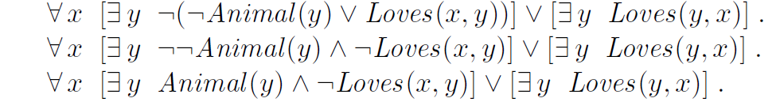
Steps to be followed
Eliminate implications:
Move ￢ inwards:

Slide 70
Standardize variables:
Skolemize: Skolemization
Here F and G are Skolem functions. the arguments of the Skolem function are all the universally quantified variables in whose scope the existential quantifier appears

Slide 71
Drop universal quantifiers:
Distribute ∨ over ∧:

Slide 72
Resolution Refutation Proofs
Convert the set of rules and facts into clause form (conjunction of clauses)
Insert the negation of the goal as another clause
Use resolution to deduce refutation
In refutation proofs, we add the negation of the goal to the set of clauses and then attempt to deduce False
Example:
Jack owns a dog
Every dog owner is an animal lover
No animal lover kills an animal
Either Jack or Curiosity killed the cat, who is named Tuna
Goal: Did curiosity kill the cat?
We will add ¬Kills(Curiosity, Tuna) and try to deduce False

Slide 73
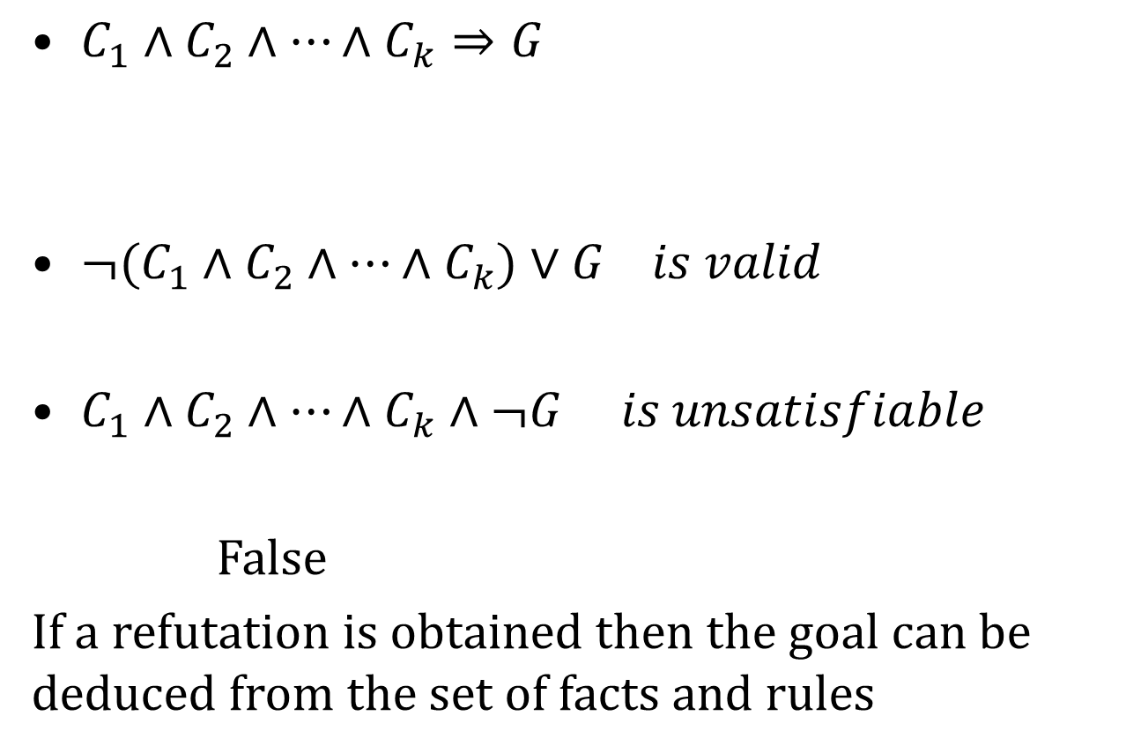
Concept

Slide 74
Example
Harry, Ron and Draco are students of the Hogwarts school for Wizards
Every student is either wicked or is a good Quidditch player or both
No Quidditch player likes rain and all wicked students like potions
Draco dislikes whatever Harry likes and likes whatever Harry dislikes
Draco likes rain and potions
Is there a student who is good in Quidditch but not in potions

Slide 75
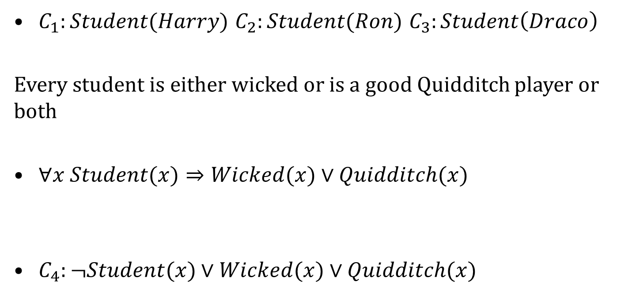
Formulation
Harry, Ron and Draco are students of the Hogwarts school for Wizards

Slide 76
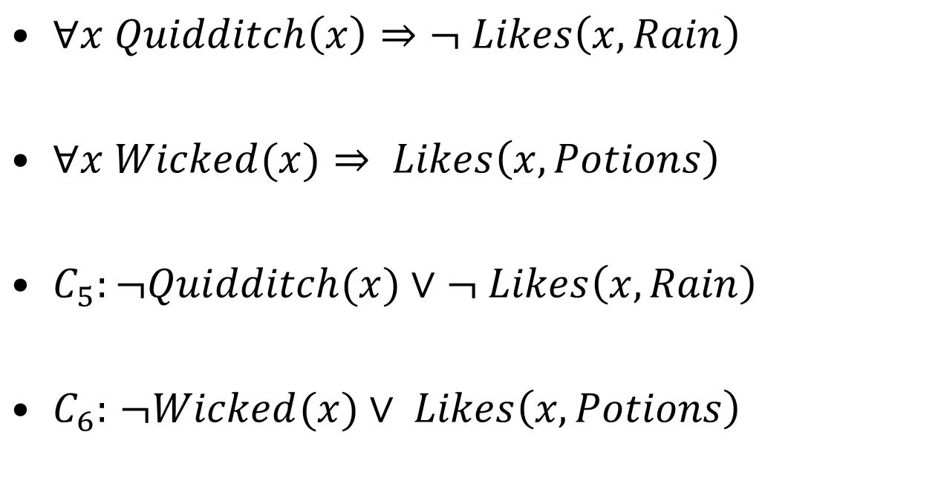
Formulation
No Quidditch player likes rain and all wicked students like potions

Slide 77
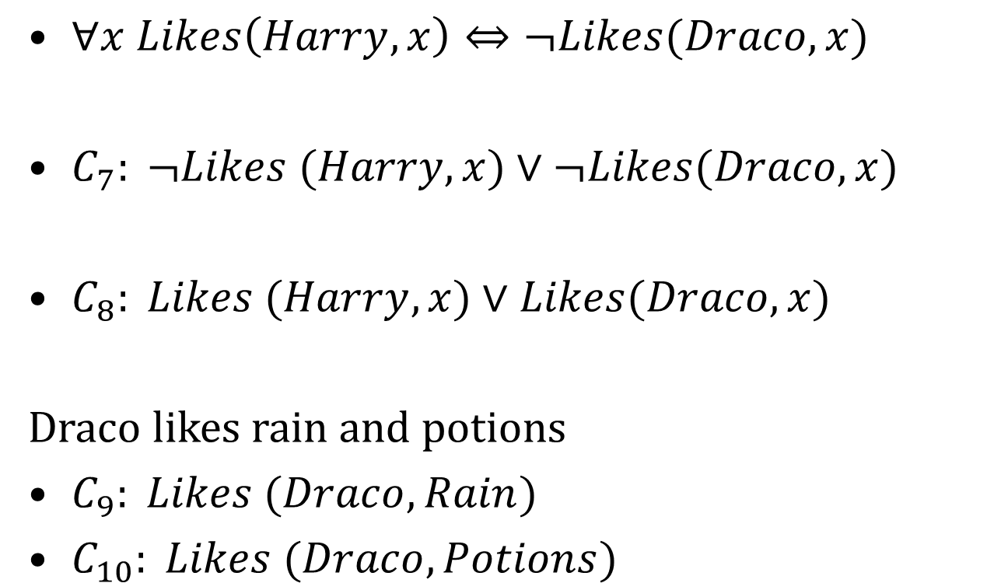
Formulation
Draco dislikes whatever Harry likes and likes whatever Harry dislikes

Slide 78
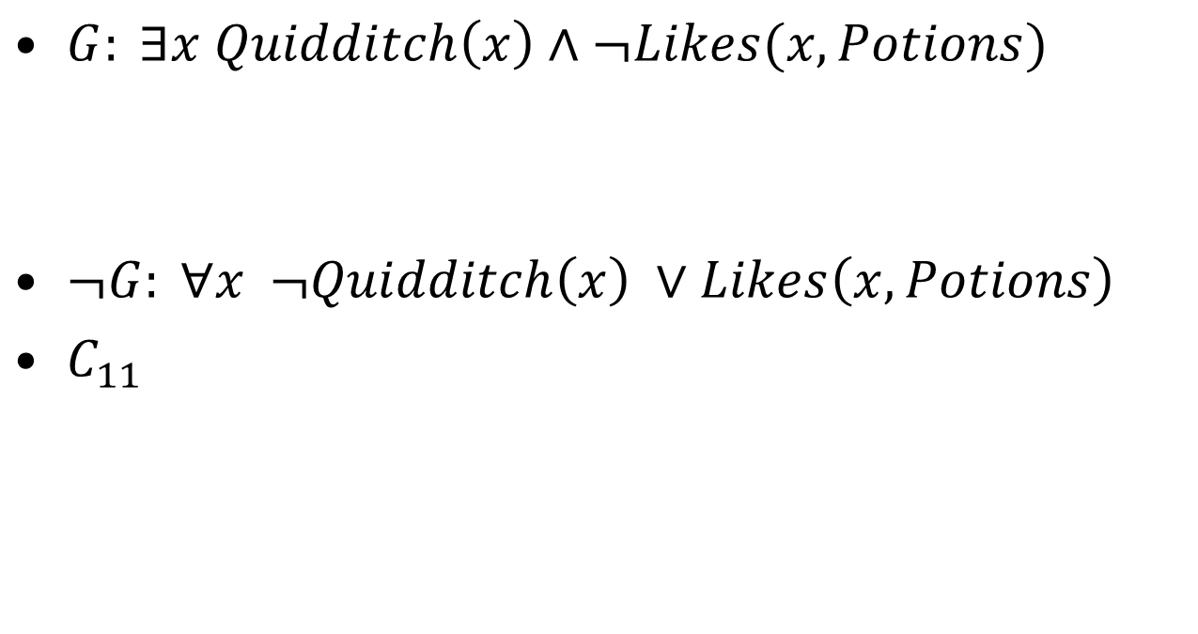
Formulation

Slide 79
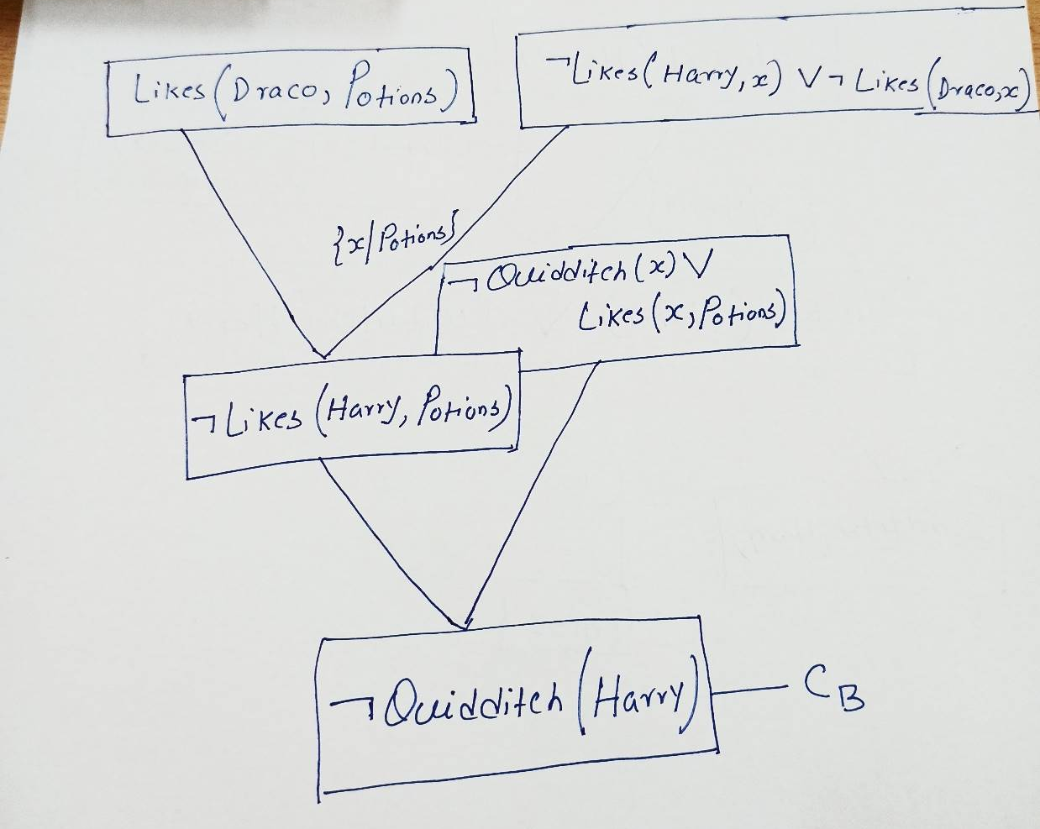
Formulation

Slide 80
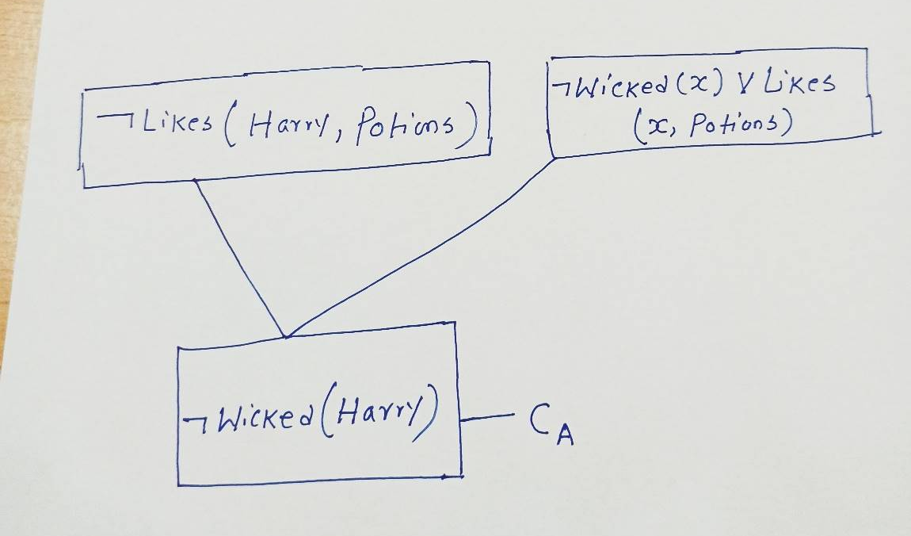
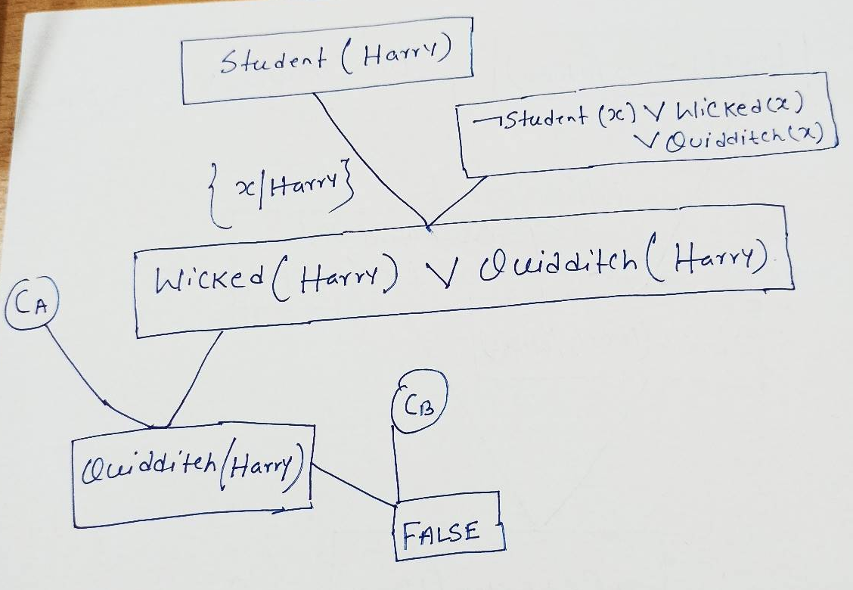
Formulation

Slide 81
Resolution Strategies
Unit Resolution
Every resolution step must involve a unit clause.
Leads to a good speed up
Incomplete in general
Complete for Horn knowledge bases

Slide 82
Resolution Strategies
Input Resolution
Every resolution step must involve a input sequence (from the query or the KB).
In Horn knowledge bases, Modus Ponens is a kind of input resolution strategy
Incomplete in general
Complete for Horn knowledge bases

Slide 83
Resolution Strategies
Linear Resolution
Slight generalization of input resolution
Allows P and Q to be resolved together either if P is in original KB, or if P is an ancestor of Q in proof tree.
Linear resolution is complete

Slide 84
General Term
Everyone who loves all animals is loved by someone.
Anyone who kills an animal is loved by no one.
Jack loves all animals.
Either Jack or Curiosity killed the cat, who is named Tuna.
Did Curiosity kill the cat?

Slide 85
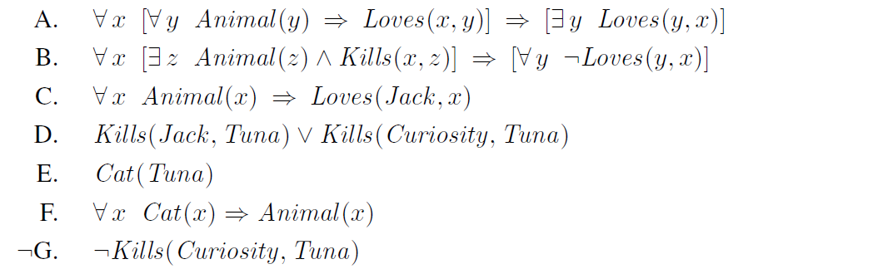
Proof
First, we express the original sentences, some background knowledge, and the negated goal G in first-order logic:

Slide 86
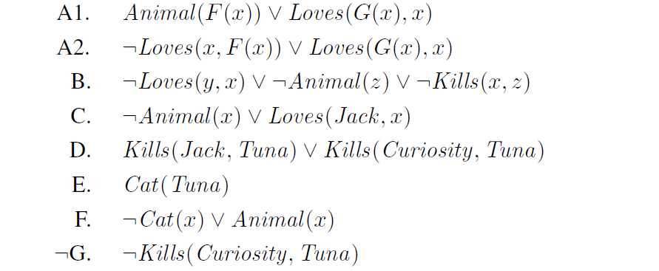
Formulation
Now we apply the conversion procedure to convert each sentence to CNF:

